Slide 1

STANDARD OPERATING PROCEDURE
USVI ISF / AMS Filing
ACE Manifest Requirements for Caribbean
Shipments via Caucedo (DR) Gateway
EFFECTIVE: MARCH 7, 2026
MANDATORY COMPLIANCE
Kestrel Liner Agencies Ltd • Caucedo Gateway Operations
9505 NW 108th Avenue, Medley, Miami, FL 33178 • +1 786 220 1650

Slide 2


What Changed & Why
The CBP Mandate
Impact on Kestrel Operations
USVI is now a U.S. point of entry in ACE Import system
All manifests must be submitted electronically via ACE
Applies to St. Thomas (STT), St. Croix (STX), St. John (STJ)
Carriers (MVOCC/NVOCC) responsible per Trade Act of 2002
Caucedo gateway shipments now require ISF/AMS for USVI vessels
Previously filed only for vessels touching Palm Beach (PPB)
Now mandatory for all vessels via St. Thomas & St. Croix
Affects ALL types: LCL and FCL — no exceptions
Key Change: Once cargo enters ANY U.S. point of entry (PPB, STT, or STX), it must be under an in-bond. Non-automated submissions will no longer be accepted.
Kestrel Liner Agencies Ltd • USVI ISF/AMS SOP • Effective March 7, 2026

Slide 3

Implementation Timeline
✓
Apr 8, 2022
USVI Trade Stakeholder Meeting
CBP issued initial electronic manifest guidelines
✓
Dec 22, 2025
CBP Notice Issued
Testing complete, ACE fully operational at all USVI ports
✓
Jan 14, 2026
Tropical Notification
Carrier forwards detailed guidance to Kestrel
Now → Mar 6
Transition Period
System upgrades, Descartes configuration, team training
Mar 7, 2026
MANDATORY GO-LIVE
Full electronic compliance — no exceptions
Kestrel Liner Agencies Ltd • USVI ISF/AMS SOP • Effective March 7, 2026

Slide 4



Before vs After
❌ BEFORE (Pre March 7)
✅ AFTER (March 7+)
CAU
PPB
STT
CAU
AMS
STT
BOND
FPOD
Caucedo
Palm Beach
St. Thomas
Caucedo
St. Thomas
Final Port
ISF/AMS filed only for vessels touching PPB. USVI was not an ACE entry point. Manual manifests accepted. No in-bond required at USVI.
ISF/AMS required for all vessels entering USVI. Electronic ACE mandatory. In-bonds required for all onward movement. USVI = U.S. port of entry.
Kestrel Liner Agencies Ltd • USVI ISF/AMS SOP • Effective March 7, 2026

Slide 5

Entry Type Decision Tree
Container arrives at USVI via Caucedo Gateway
Is the vessel touching a U.S. Port? (STT, STX, PPB)
YES → FILE ISF/AMS IN DESCARTES
What is the Final Port of Destination (FPOD)?
AGSJO, SXPHI, GDSTG,
LCCAS/LCVIF, VCKTN/VCCRP
All Other FPODs
BSNAS, KYGCM, TCPLS, USPAB, etc.
🚢 FROB ENTRY
Freight Remaining on Board
📋 REGULAR B/L ENTRY
Standard Bill of Lading
Cargo transits USVI without discharge
Requires in-bond (IE or TE) for onward movement
Kestrel Liner Agencies Ltd • USVI ISF/AMS SOP • Effective March 7, 2026

Slide 6

FROB Entry Destinations
Containers with FPOD to these destinations require FROB (Freight Remaining on Board) entries. Cargo transits USVI without discharge.
🇻🇨
St. Vincent
VCKTN / VCCRP
Kingstown / Campden Park
🇸🇽
St. Maarten
SXPHI
Phillipsburg
🇬🇩
Grenada
GDSTG
St. George
🇱🇨
St. Lucia
LCCAS / LCVIF
Castries / Vieux Fort
🇦🇬
Antigua
AGSJO
St. John's
Remember: FROB = cargo stays on vessel through USVI. If discharged at USVI for connection, it becomes a Regular B/L with in-bond.
Kestrel Liner Agencies Ltd • USVI ISF/AMS SOP • Effective March 7, 2026

Slide 7

Regular B/L Entry Destinations
All destinations NOT listed as FROB require Regular B/L Entry with in-bond (IE or TE) for onward movement.
🇧🇸
Nassau, Bahamas
BSNAS
🇩🇲
Dominica (Roseau)
DMRSU
🇧🇸
Freeport, Bahamas
BSFPO
🇦🇮
Anguilla
AIBLP/AIRBY
🇰🇾
Grand Cayman
KYGCM
🇧🇱
Gustavia, St. Barths
BLGUS
🇹🇨
Providenciales, T&C
TCPLS
🇧🇱
St. Barths
GPSBH
🇹🇨
Grand Turks, T&C
TCGDT
🇻🇬
Tortola, BVI
VGRAD
🇰🇳
St. Kitts
KNBAS
🇻🇬
Virgin Gorda, BVI
VGVIJ
🇰🇳
Charlestown, Nevis
KNNEV
🇺🇸
West Palm Beach
USPAB
Kestrel Liner Agencies Ltd • USVI ISF/AMS SOP • Effective March 7, 2026

Slide 8

USVI Port Codes for ACE
Configure these in Descartes. Use 5-digit as Port of Lading, 4-digit as Port of Unlading.
USVI Port | Foreign Code (5-digit) | Domestic Code (4-digit) | Kestrel Code
St. Thomas (STT) | 91155 | 5101 | VISTT / VICHA
St. John (STJ) | 91195 | 5102 | VICZB
St. Croix (STX) | 91149 | 5104 | VISTX
Foreign-Origin Shipments
Use 4-digit domestic code as port of unlading. Create unique IATA-style codes — cannot reuse STT for both 4 and 5-digit codes.
CONUS-Origin Shipments
Use 5-digit foreign code as Port of Lading and 4-digit as Port of Unlading. This triggers ACE tracking.
Kestrel Liner Agencies Ltd • USVI ISF/AMS SOP • Effective March 7, 2026

Slide 9
Master Port Codes Reference
USVI (U.S. ENTRY POINTS)
St. Thomas
VISTT / VICHA
Cruz Bay, St. Johns
VICZB
St. Croix
VISTX
FROB DESTINATIONS
Antigua
AGSJO
Grenada
GDSTG
St. Lucia
LCCAS/LCVIF
St. Maarten
SXPHI
St. Vincent
VCKTN/VCCRP
REGULAR B/L DESTINATIONS
Anguilla
AIBLP/AIRBY
Gustavia
BLGUS
Freeport
BSFPO
Nassau
BSNAS
Dominica
DMRSU
St. Barths
GPSBH
St. Kitts
KNBAS
Nevis
KNNEV
Grand Cayman
KYGCM
Grand Turks
TCGDT
Providenciales
TCPLS
Tortola
VGRAD
Virgin Gorda
VGVIJ
W. Palm Beach
USPAB
Kestrel Liner Agencies Ltd • USVI ISF/AMS SOP • Effective March 7, 2026

Slide 10

Scenario 1: CAU → USVI → Foreign Destination
CAU
VESSEL
STT
CONNECT
FPOD
Caucedo, DR
VISTT
Foreign Dest.
ENTRY TYPE
BOND TYPE
ISF/AMS
IE In-Bond
Immediate Export
Required
Container from Caucedo discharges at St. Thomas, connects to foreign destination. NVOCC creates IE in-bond at USVI (first U.S. port of call). Example FPODs: GDSTG, LCCAS, SXPHI.
Kestrel Liner Agencies Ltd • USVI ISF/AMS SOP • Effective March 7, 2026

Slide 11
Scenario 2: CAU → USVI → PPB → Caribbean
CAU
VESSEL
STT
TE BOND
PPB
EXPORT
FPOD
Caucedo
VISTT
USPAB
NAS/GCM/PLS
ENTRY TYPE
BOND TYPE
ISF/AMS
TE In-Bond
Transport & Export
Required
Container enters USVI (first U.S. port), transits to PPB under TE in-bond, then exported to Caribbean. Example FPODs: BSNAS, KYGCM, TCPLS, TCGDT.
Kestrel Liner Agencies Ltd • USVI ISF/AMS SOP • Effective March 7, 2026

Slide 12
Scenario 3: HAL → PPB → Remains on Board for USVI
HAL
VESSEL
PPB
IE BOND
STT
DELIVER
FPOD
Hamburg
USPAB
On Board
Foreign
ENTRY TYPE
BOND TYPE
ISF/AMS
IE In-Bond
Immediate Export
Required
Vessel from foreign origin discharges at PPB. Containers for Tropical foreign destinations remain on board. NVOCC issues IE bond at PPB.
Kestrel Liner Agencies Ltd • USVI ISF/AMS SOP • Effective March 7, 2026

Slide 13
Scenario 4: HAL → PPB → USVI Discharge → Foreign
HAL
VESSEL
PPB
TE BOND
STT
EXPORT
FPOD
Hamburg
USPAB
Discharge
Foreign
ENTRY TYPE
BOND TYPE
ISF/AMS
TE In-Bond
Transport & Export
Required
Foreign-origin cargo discharges at PPB, transits to USVI under TE bond for discharge and connection to Tropical foreign destinations. TE filed from PPB to STT for export.
Kestrel Liner Agencies Ltd • USVI ISF/AMS SOP • Effective March 7, 2026

Slide 14

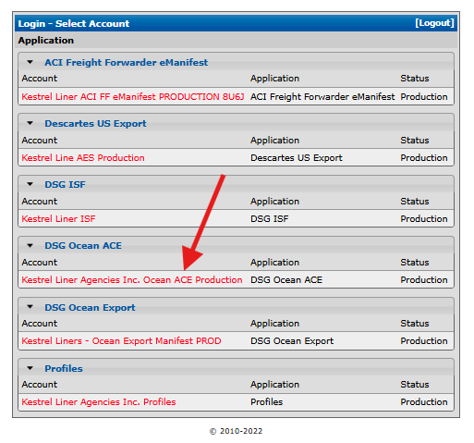
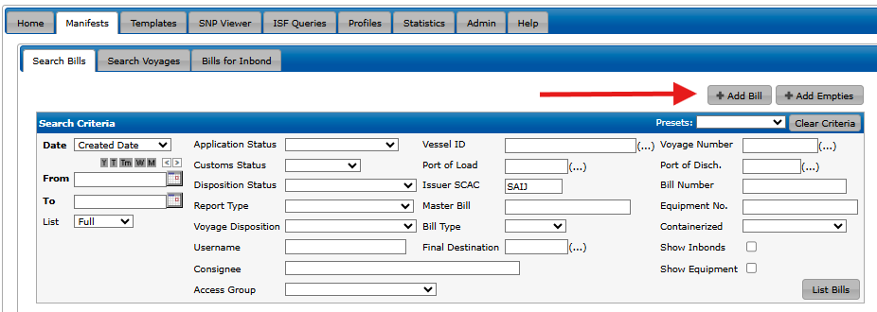
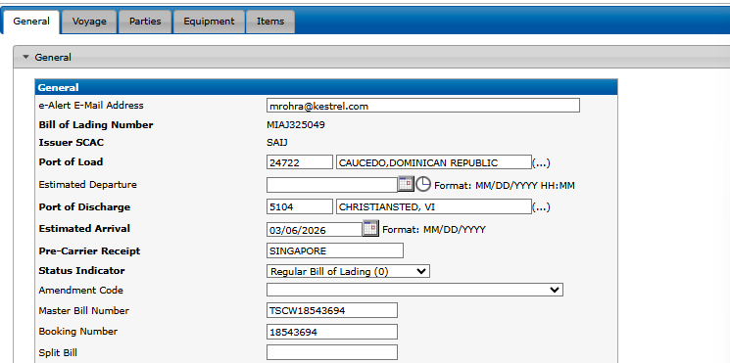
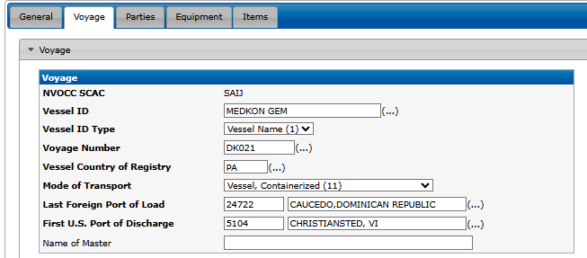
AMS Manifest Filing in Descartes
Follow these steps in Descartes.
STEP 1
STEP 2
📸 INSERT SCREENSHOT
Navigate to ISF Module — Descartes → DSG Ocean ACE
Create New ISF/AMS — Click on Add Bill
STEP 3
STEP 4
Select USVI Port — Domestic code: 5101 (STT) / 5102 (STJ) / 5104 (STX)
Enter Vessel & Voyage — Vessel name, voyage number, ETA
Kestrel Liner Agencies Ltd • USVI ISF/AMS SOP • Effective March 7, 2026

Slide 15
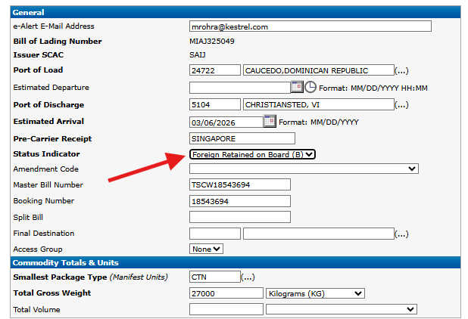
FROB B/L Entry
Under Status Indicator: Please select Foreign Retained on Board (B)
STEP 1
STEP 2
STEP 3
STEP 4
FROB DESTINATIONS
Antigua
AGSJO
Grenada
GDSTG
St. Lucia
LCCAS/LCVIF
St. Maarten
SXPHI
St. Vincent
VCKTN/VCCRP
Kestrel Liner Agencies Ltd • USVI ISF/AMS SOP • Effective March 7, 2026

Slide 16
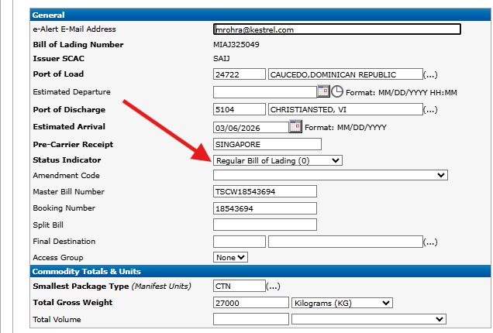
Regular B/L Entry Creation
Under Status Indicator: Please select Regular Bill of Lading
STEP 1
STEP 2
STEP 3
STEP 4
REGULAR B/L DESTINATIONS
Anguilla
AIBLP/AIRBY
Gustavia
BLGUS
Freeport
BSFPO
Nassau
BSNAS
Dominica
DMRSU
St. Barths
GPSBH
St. Kitts
KNBAS
Nevis
KNNEV
Grand Cayman
KYGCM
Grand Turks
TCGDT
Providenciales
TCPLS
Tortola
VGRAD
Virgin Gorda
VGVIJ
W. Palm Beach
USPAB
Kestrel Liner Agencies Ltd • USVI ISF/AMS SOP • Effective March 7, 2026

Slide 17
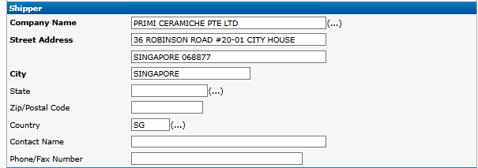
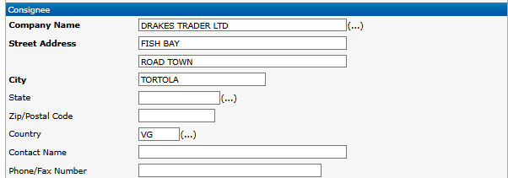
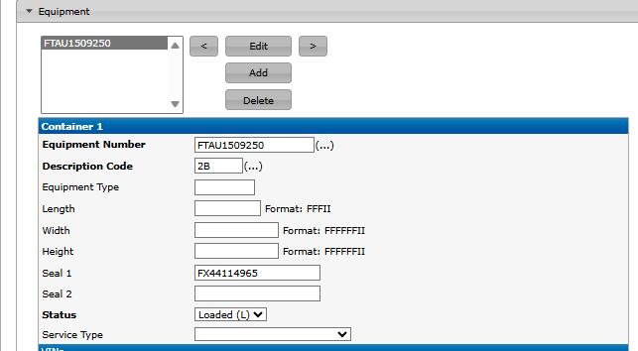
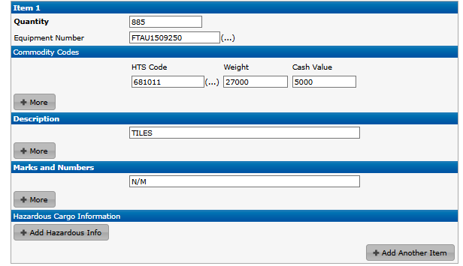
AMS Manifest Filing
Follow these steps in Descartes. Add your screenshots to each placeholder.
STEP 5
STEP 6
Create New ISF/AMS — Shipper, HTS codes, seal #
Create New ISF/AMS — Enter Consignee Information
STEP 7
STEP 8
Create New ISF/AMS —Equipment, Seal #
Create New ISF/AMS — HTS codes, Weight, Description, Marks and Click Submit
Kestrel Liner Agencies Ltd • USVI ISF/AMS SOP • Effective March 7, 2026

Slide 18
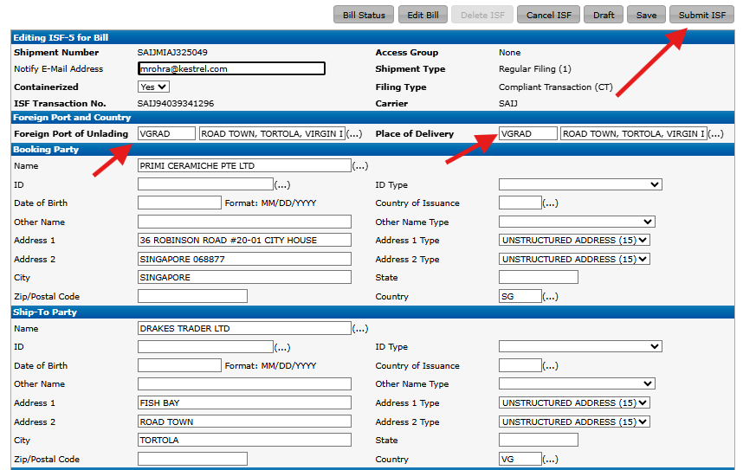
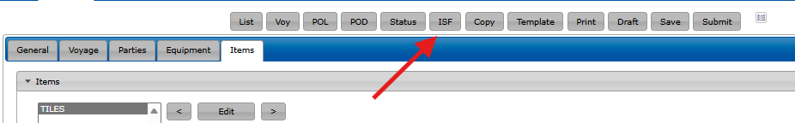
ISF5 Filing
Follow these steps in Descartes. Add your screenshots to each placeholder.
STEP 9
STEP 10
Click on ISF for ISF5 Entry
Enter Correct Foreign Port of Unlading (FPOD)
Kestrel Liner Agencies Ltd • USVI ISF/AMS SOP • Effective March 7, 2026

Slide 19

NVOCC Bond Requirements
Who Must Create Bonds?
NVOCCs must issue an in-bond for all cargo entering a U.S. point of entry (USVI or PPB). Bonds allow cargo to legally move to its next destination. Must be filed in Descartes before arrival.
Cargo Entering via PPB First
Cargo Entering via USVI First
Create in-bond at PPB for foreign-origin cargo. Arrival reported to CBP to confirm entry into U.S. zone. Cargo sails to USVI or other destinations under bond.
Create in-bond (IE or TE) at USVI as first U.S. port of call. This is the new requirement. Applies to all Caucedo-origin cargo routing through STT/STX.
Benefits of Compliance: Advance CBP risk assessment • "1C" Customs release opportunity • Reduced in-port inspections • Faster processing times
Kestrel Liner Agencies Ltd • USVI ISF/AMS SOP • Effective March 7, 2026

Slide 20
In-Bond Types: IE vs TE
IE
Immediate Export
TE
Transportation & Export
Cargo enters U.S. port and is immediately exported to foreign destination without moving through U.S. territory.
Cargo enters U.S. port and must transit through U.S. territory before export to final foreign destination.
Scenarios:
Scenarios:
HAL → PPB discharge → remains on board for Tropical foreign (IE at PPB)
CAU → USVI → discharge & connect to foreign (IE at USVI)
HAL → PPB → STT for connection to foreign (TE from PPB to STT)
CAU → USVI → PPB for NAS, GCM, PLS, BCB (TE from USVI)
Kestrel Liner Agencies Ltd • USVI ISF/AMS SOP • Effective March 7, 2026

Slide 21

Quick Reference Card
Is ISF required for USVI shipments?
Is AMS required?
YES — All shipments after March 7, 2026
YES — Electronic ACE manifest mandatory
Which system do we file in?
FROB vs Regular B/L?
Descartes — ISF, AMS, FROB, Regular B/L
FROB = AGSJO, SXPHI, GDSTG, LCCAS, VCKTN. Others = Regular B/L
When does this take effect?
Cut-off for filing ISF/AMS Entries
March 7, 2026 — No exceptions
AMS cut-off is Monday End of Day for the Wednesday Vessel.
What in-bond types?
Who is responsible?
IE = Immediate Export, TE = Transportation & Export
Carrier (MVOCC/NVOCC) per Trade Act of 2002
Kestrel Liner Agencies Ltd • USVI ISF/AMS SOP • Effective March 7, 2026

Slide 22

Contacts & Resources
Kestrel — Caucedo Gateway
Kestrel Miami
📧 caucedogateway@kestrel.com
📞 +1 786 220 1650
📍 9505 NW 108th Ave, Medley
Miami, FL 33178
Manish Rohra (Operations)
📧 mrohra@kestrel.com
📞 786-220-1650 ext 1695
📱 786-770-4856
ACE Support Desk
Tropical Shipping
📧 servicedesk@descartes.com
Julissa Moreta
📧 Jmoreta@tropical.com
Heyddy Melissa
📧 hpichardopimentel@tropical.com
Kestrel Liner Agencies Ltd • USVI ISF/AMS SOP • Effective March 7, 2026

